Slide 1



TERRA
Tracking and Environmental Real-time Response Apparatus
Research and Execution Team
Samsun Naher Maisha
Research Lead Department of Oceanography at Noakhali Science & Technology University
Mahdi Sajjad Neloy
Engineering Lead Computer Engineer
Tasmia Akhter
Research Assistant Department of Mathematics at Noakhali Science & Technology University
S.M. Emon Rashid
Engineering Department of Avionics Technology at Aeronautical Institute of Bangladesh
Ashfaqur Rahman Chowdhury
SDG Planning Coordinator Department of Architecture at Shahjalal University Of Science & Technology
Faisal Hossain
Embedded Engineer Electrical Engineer

Slide 2

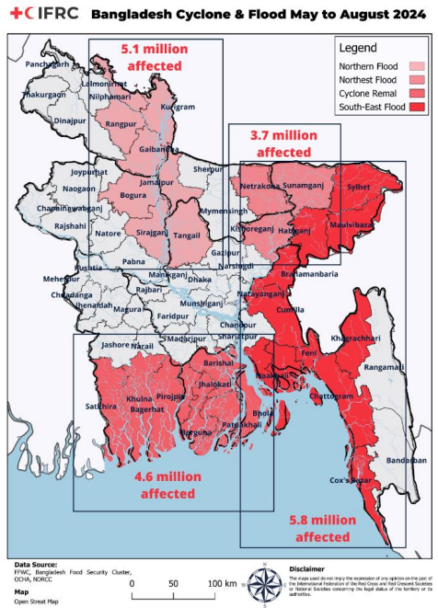

PROBLEM
The lack of Real-Time Data for Early Flood Detection System that leads to infrastructural damage, hampers agriculture production and increases the risk of damage to human lives.
Emergency appeal №: MDRBD036 | International Federation of Red Cross

Slide 3

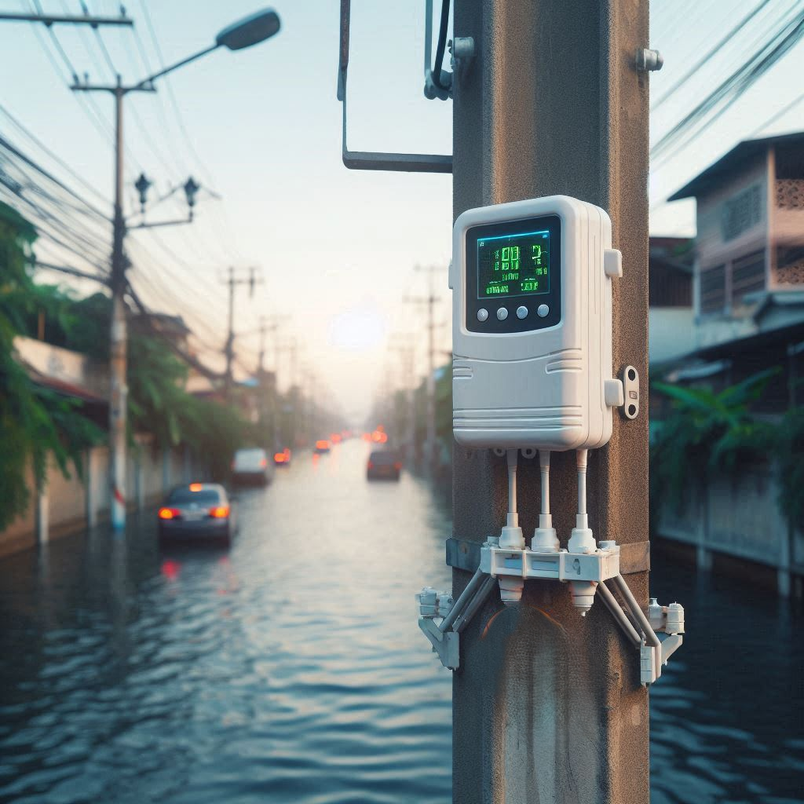



SOLUTION : TERRA
Tracking and Environmental Real-time Response Apparatus - Early Flood Warning System
Real time Data
Water levels,
Humidity
Temperature
Air quality
Automated and Reliable
Automated Flood Data and Calculative Prediction
Multiple connectivity (Wi-Fi,GSM and LoRa WAN)
Early Warning System APP
Provides real-time data for informed decision-making and reducing Damage.
Revolutionizing Disaster Management Through Real-Time Data .
3

Slide 4
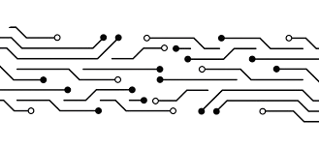
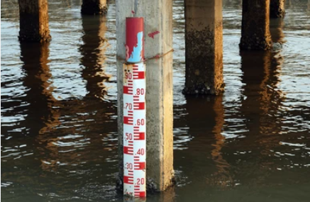
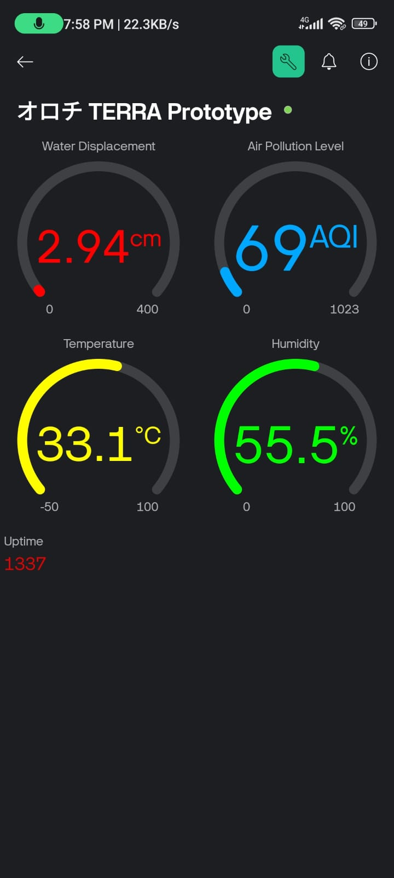
TECHNOLOGY
Instead of the Statistical water mapping data , we are bringing a calculative Situational prediction system specially Flood.
Real time Flood Prediction Model
All the Data Collection TERRA modules are interconnected . It has Modular Design Structure that Enables expandability .Uninterrupted Data Transmission Via WiFi , GSM & LoRa WAN
Manual River water Measurement
IoT & Modularity
The TERRA modules Collects critical Flood data and transmits directly to the Central server for Data analysis and Live Data Demonstration.
Data Analysis & Near Computing
TERRA Mobile App Prototype

Slide 5
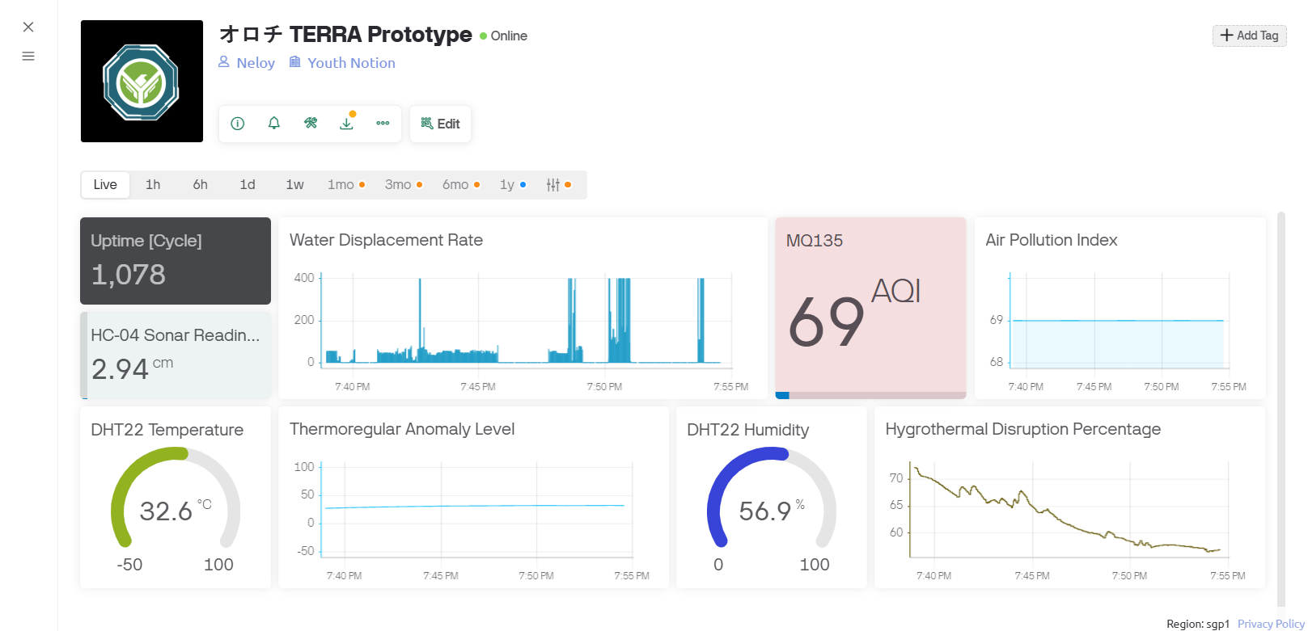
INNOVATION
01
Early Flood Detection System
02
User App for Flood Alerts and climate warnings.
03
Illustration of Live weather Demographics
TERRA Web Portal Prototype
04
Live Data Based - Real Time Prediction Model
05
Modular Design Enables options to add more sensors : Rain, Water Salinity ,Soil Quality , PH etc.

Slide 6
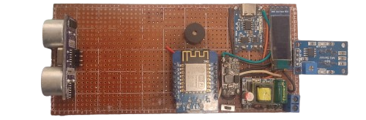
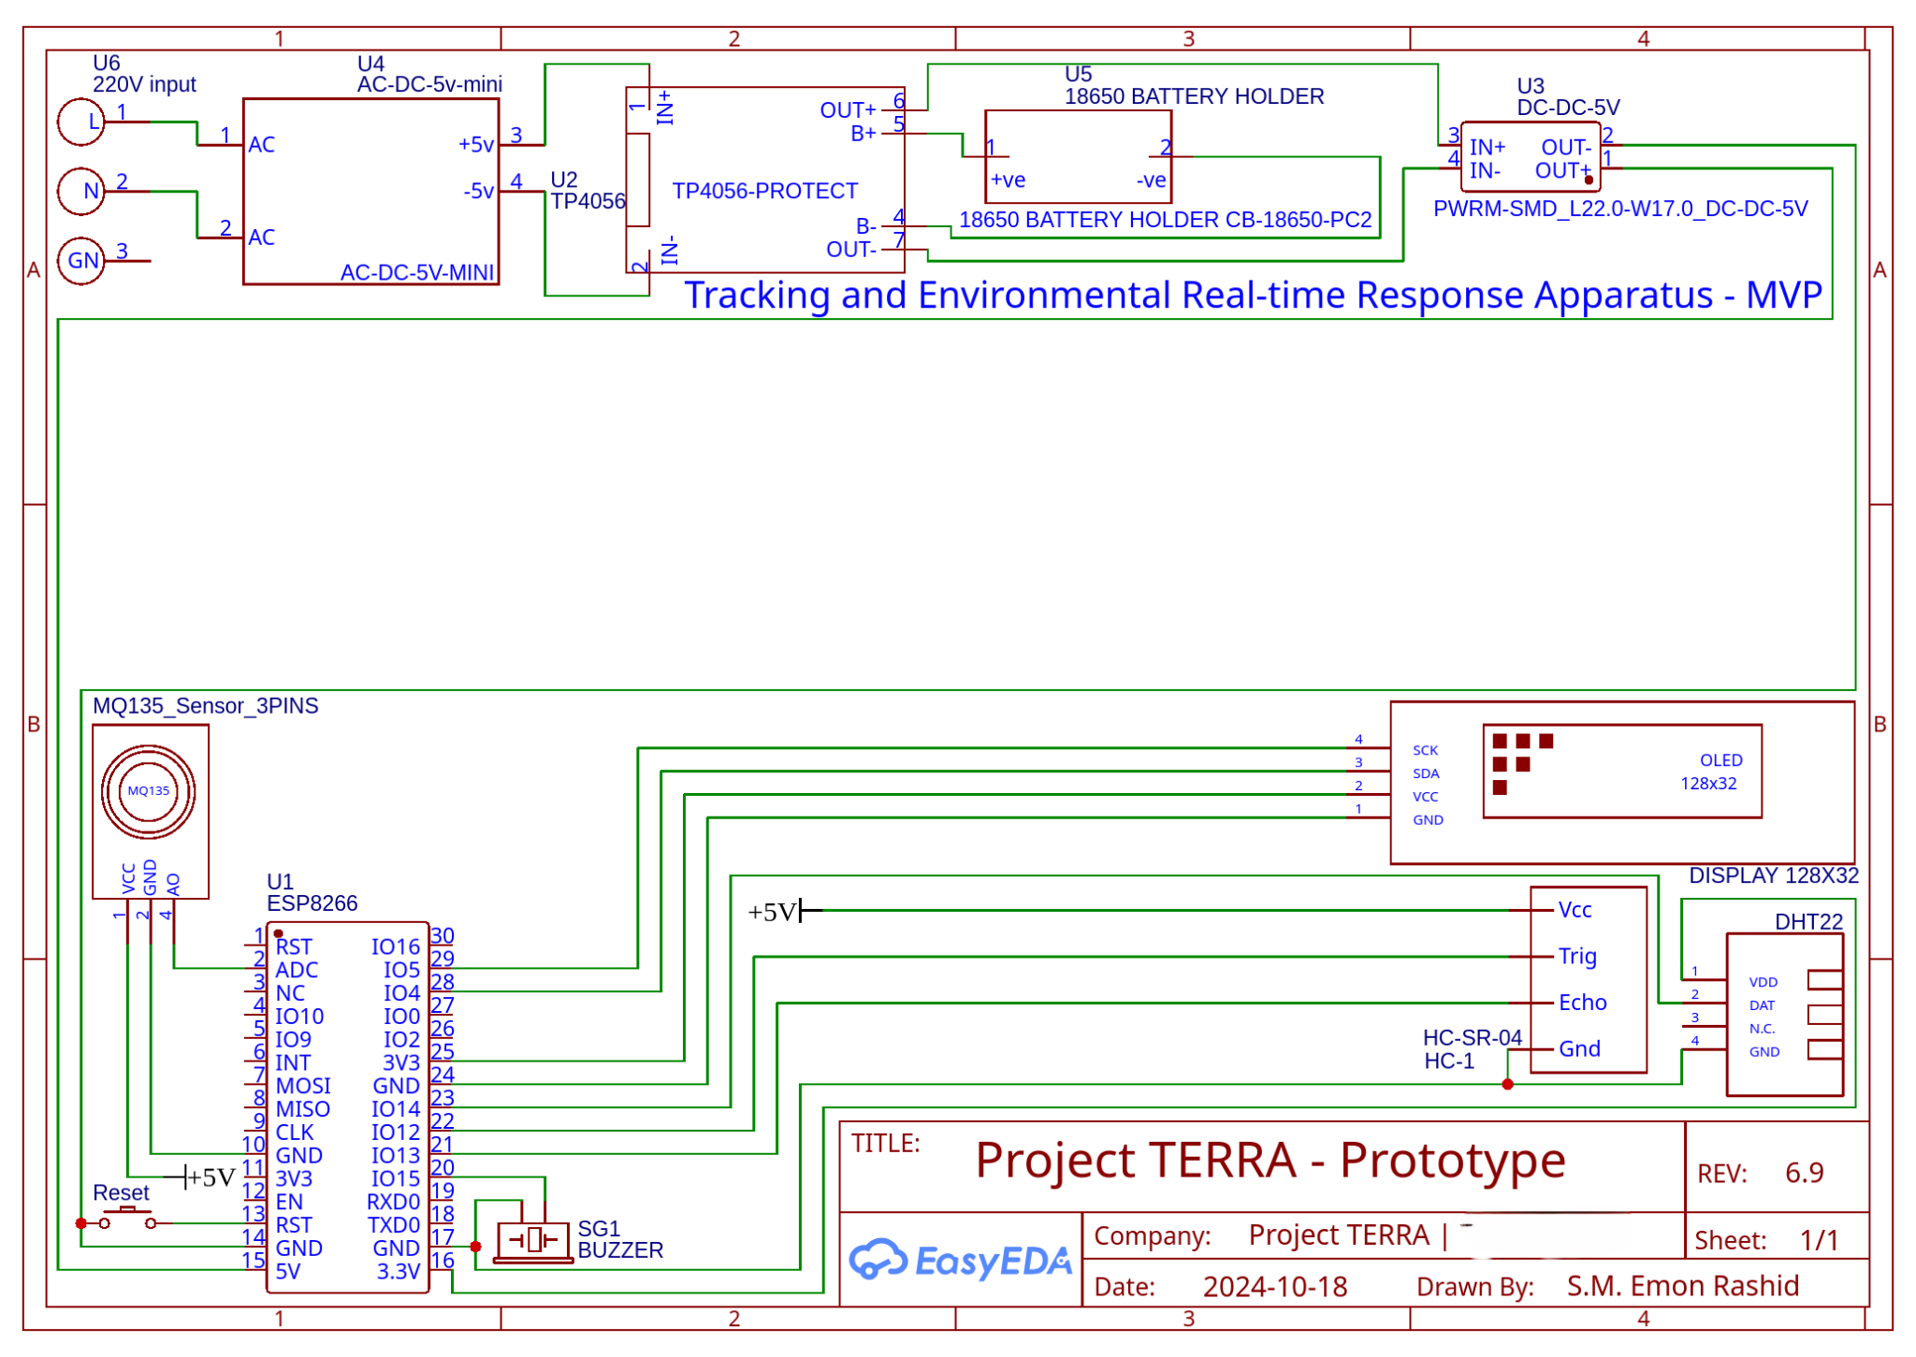
TECHNOLOGY
TERRA hardware module Prototype

Slide 7

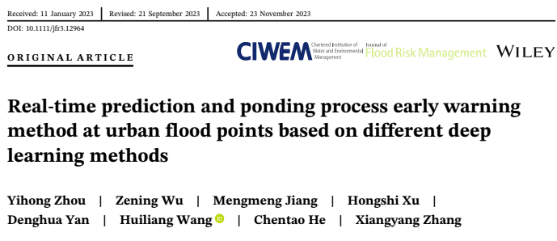
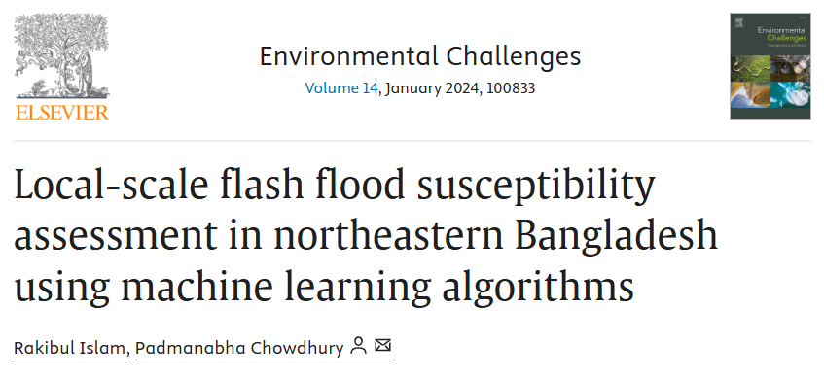
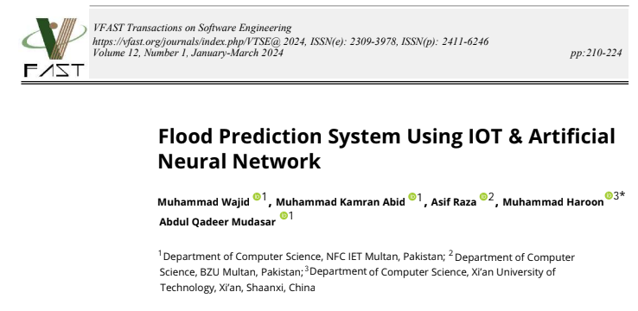
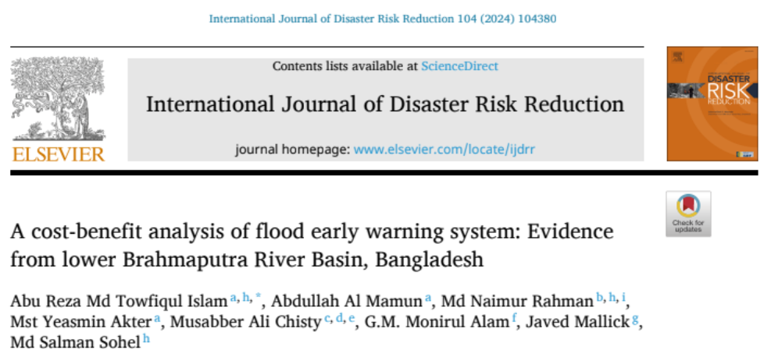

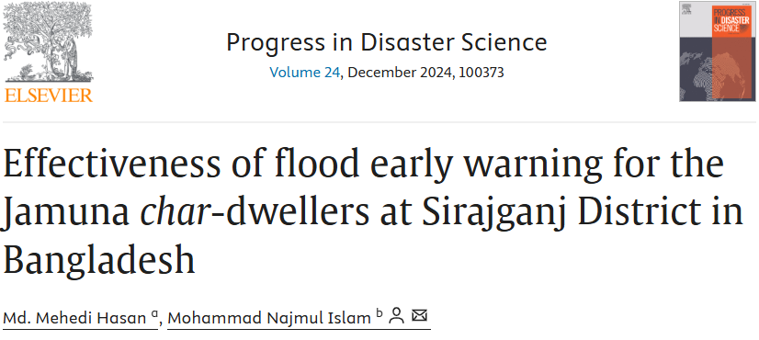
FEASIBILITY STUDY
Materials availability , cost-benefit ratio our supporting background , research , weatherproof enclosure
Materials Availability
Cost-Benefit Ratio
Prototype Study
Current Equipments are ESP8266, DHT22, MQ135, HC-04, TP4056 BMS, DC-DC boost converter, AC-DC 5V adapter, 18650 battery .
Is widely available in the local markets.
In affordable price .
A single weather station costs 27 lakh BDT to establish.
TERRA offers similar 50 km radius coverage for 5 lakh BDT.
Hardware prototype and early warning system monitored for 6 months in (Dhaka Division).
Ongoing research on the prediction model continues.
Relevant Research Papers

Slide 8
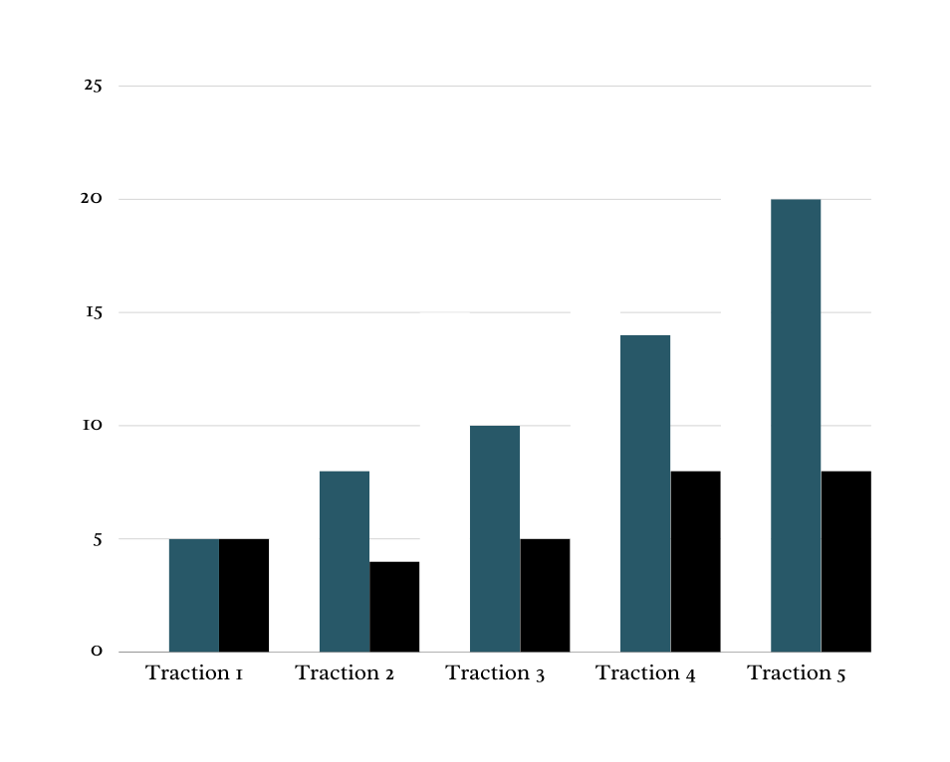

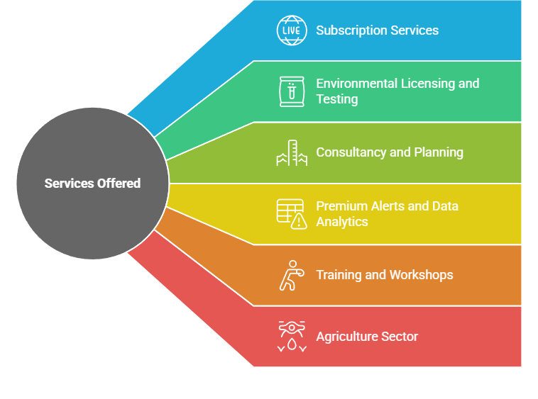
BUSINESS MODEL
B2G
Service: Real-time flood data, predictive analytics,
Clients: Government agencies.
Use: Disaster management, infrastructure planning, emergency response.
B2B
Platform: Subscription Based Web portal
Target clients: NGOs, insurance companies, agriculture firms, and real estate developers.
Purpose: Mitigate financial and operational risks.
B2C
Platform : Mobile app
Target users: Farmers, homeowners, and commuters.
Monetization model: Subscription-based or freemium.

Slide 9


MARKET OPPORTUNITY
USD 6.13 billion
USD 6.13 billion Source: Mordor Intelligence
TAM
Global climate consultancy market
USD 15 million Source: LightCastle Analytics Wing
Global Agri-Tech market
SAM
5% of National Financial Loses
SOM
Our Service Obtainable market
BDT 14,421.46 crore in damage from Eastern Region floods: CPD
According to: Center for Policy Dialogue , October 6, 2024
People without Early Flood Warning faced a damage of over 11M USD others 4M . BANGLADESH: CYCLONE AND MONSOON FLOODS HUMANITARIAN RESPONSE PLAN, JUNE 2024 - MARCH 2025 Page:11

Slide 10
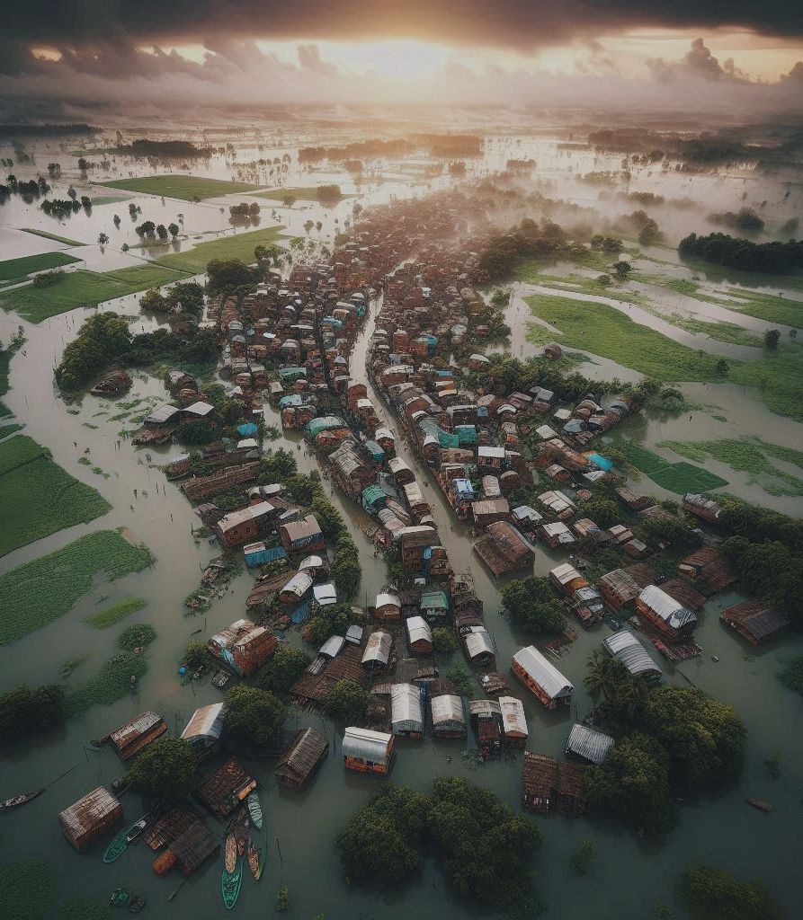
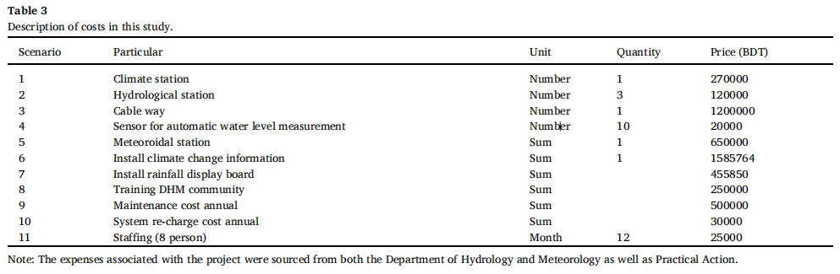


COMPETITION
A cost-benefit analysis of flood early warning system: Evidence from lower Brahmaputra River Basin, Bangladesh Author links open overlay panel Abu Reza Md Towfiqul Islam a h . | ResearchGate
A single Weather Station Establishment Costs 27 Lakh BDT While a single TERRA module costs around 5k BDT

Slide 11







POTENTIAL PARTNERSHIP

Slide 12





IMPACT & SDG ALIGNMENTS :
Relevant Research That Proves the Impact of Our System

Slide 13

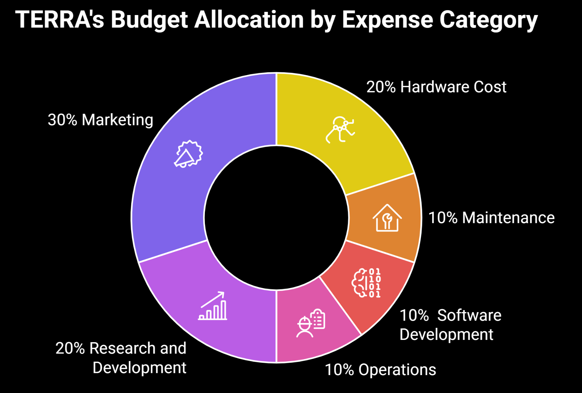
THE ASK

Slide 14
Thank you

